Slide 1
Math Anxiety Workshop
-Supplemental Learning Workshop

Slide 2
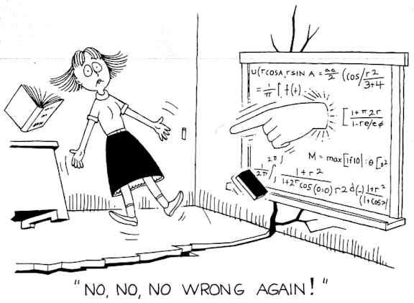

Slide 3
Do any of the following testimonials sound or feel familiar?
When I look at a math problem, my mind goes completely blank. I feel stupid, and I can’t remember how to do even the simplest things. I've hated math ever since I was nine years old, when my father grounded me for a week because I couldn’t learn my multiplication tables. In math there’s always one right answer, and if you can’t find it you've failed. That makes me crazy. Math exams terrify me. My palms get sweaty, I breathe too fast, and often I can't even make my eyes focus on the paper. It’s worse if I look around, because I’d see everybody else working, and know that I’m the only one who can’t do it. I've never been successful in any math class I've ever taken. I never understand what the teacher is saying, so my mind just wanders. Some people can do math – not me!

Slide 4
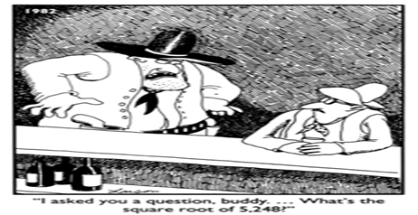
Is this how you feel when your instructor asks you a question in class?

Slide 5
Sharing
Would anyone like to share a past experience that has influenced your opinion or perception of math in a positive or negative way?
Perhaps a previous:
Teacher
Friend
Family member
Math class
Other

Slide 6
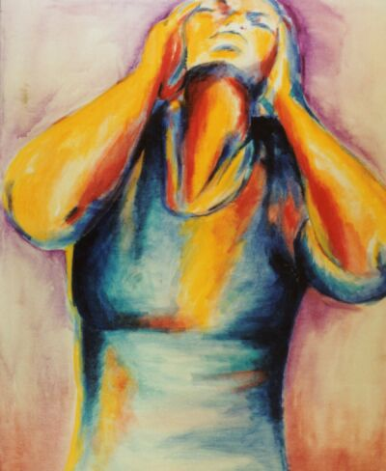

What is Math Anxiety?
Math anxiety is a feeling of intense frustration or helplessness about one’s ability to do math.
Math anxiety can be a disabling condition and cause feelings of:
Humiliation
Resentment
Panic
Do you think these feelings about math are common?
Most people/students do not realize that these feelings about math are shared among all of us to some degree.

Slide 7

Math Anxiety Contributing Elements
Body and Mind
Physiological
Rapid Heart Rate
Sweating
Muscle Tension
Upset Stomach
Shaking
Psychological
Feeling Overwhelmed
Low Self-Confidence
Mind Goes Blank
Procrastination
Avoidance

Slide 8
Social Causes and Educational Contexts
Consider the following:
Imagine you are at dinner with family and friends when someone asks, “Can anyone help me divide up the check? I’ve never been good at math.”
Do you think this is unusual?
Now consider:
Someone asks, “Could someone read me the menu? I’ve never been a good reader and haven’t learned how.”
Do you think this is unusual?
More or less unusual than the math statement above?
This scenario or example illustrates the tarnished reputation that mathematics has in our society. The view that it is alright not to be proficient in math. It is socially acceptable to hate/not be good at math.

Slide 9
Social causes and educational contexts continued…
Mathematics has a tarnished reputation in our society.
People who enjoy math are often treated as though they are not quite normal. (Nerd!!)
Some school teachers communicate this attitude to their students directly or indirectly.
In some countries, such as Russia and Germany, mathematics is viewed as an essential part of literacy.
Teaching methods have relied on memorization and repetition.
Women continue to face an additional barrier to success in mathematics.

Slide 10
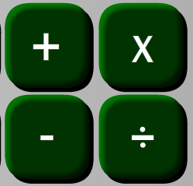
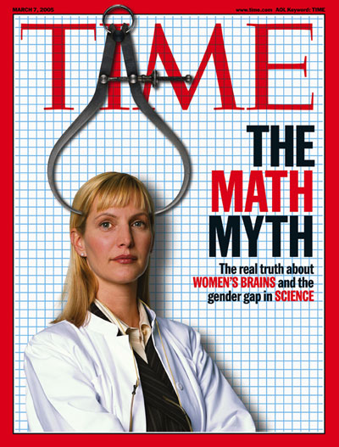
True or False?
To be good at math you have to be good at calculating?
False. Many students are quicker at calculations than their teachers. Being good at calculating does help but does not make one good at math.
In math, all that is important is getting the right answer?
False. The correct answer is important, but that is not all that is important. The journey or path you use to arrive at your answer is also important. Being able to demonstrate and show what you are doing in your work is a key component to success in math.
Men are naturally better than women at mathematical thinking?
False. This myth is a contributing factor women continue to face in the success of mathematics. Studies have shown that math excellence in females correlates well with measures of gender equality.

Slide 11
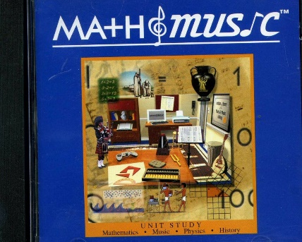
True or False?
Math requires logic and no creativity?
False. Logic is an important aspect of mathematics; however, mathematics has also been influential in many other creative fields such as dance, theater, magic, and architecture.
Mathematics and Music
Greeks: Discovered that the musical tones most pleasing to the ear are those achieved by dividing a plucked string into ratios of integers. For instance, the musical interval of a “fifth” is achieved by plucking a taut string whilst pressing the finger against it at a distance exactly four-fifths along its total length.
Mathematics and Mime
In "Envisioning the Invisible", Tim Chartier describes how the performing arts can be used to capture mathematical concepts in a visceral way that audiences can really connect with. Chartier is a mathematician and also a mime and in one of his sketches he gets the audience to visualize the one-dimensional number line as a rope of infinite length. The sketch begins with the lone mime walking toward the audience and suddenly stumbling. Peering down, he sees an (invisible) object on the floor and proceeds to slowly pick it up. Examining it, he discovers a rope of infinite length in both directions. He then engages in a tug-of-war with the rope and eventually cuts it into two, prompting the audience to ponder questions about the nature of infinity.
Let us look at a couple of other popular myths…

Slide 12
Myth: You need a “math brain” to do math.
Myth: I will never need math.
We use math everyday:
Money, distance/speed, time
Math is a common language
Math is required to complete your goal of getting a degree.
Anyone can do math!
If you don’t have a “math brain” now, you can grow one.
You can train for a marathon even if you’re not a good runner. You can train for being a better math student!
Your math teachers were math students before as well. Many times they struggled with math and had to keep practicing in order to understand the material.

Slide 13
Myth: Aiming for a “C” is fine.
Aiming for a “C” does not give you any wiggle room.
Even though a “C” is passing, it indicates that you are not as well prepared for the next class as someone with an “A” or a “B”.
Myth: There is only one way to do math.
Each person has their own unique math style.
A professor or tutor may teach you the way THEY understand best.
It is up to you to find the right way for you.

Slide 14
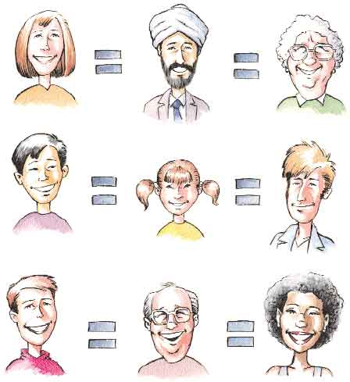
Myth: I can’t do math because I’m: a girl, a boy, too young, too old, etc.
There are no limits to who can do math.
If you can’t do math now, it’s probably because :
People around you didn’t think you could do math.
You haven’t had enough good math experiences.
You haven’t found YOUR way of doing math.

Slide 15
Taking Possession of Math Anxiety
Recognize that math anxiety is an emotional response. A little anxiety is normal, a lot of anxiety is learned.
Unconstructive ways to manage math anxiety:
Rationalization
Using math myths and misconceptions as reasons why it is okay for you to have this reaction. The myths discussed above are examples of rationalizations, and while they may make you feel better (or at least less bad) about having math anxiety, they will do nothing to lessen it or to help you get it under control. Therefore, rationalization is unconstructive.
Suppression
Anxious about having this anxiety and not talking about it. In response, trying to suppress and not feel it. This technique is commonly attempted by students and is usually accompanied by self-criticism. This tends to lead to a deep sense of frustration and often a severe loss of self-esteem. Consequently, suppression of math anxiety is not only unconstructive, but can actually be damaging.
Denial
Choosing a major just because it requires little to no math. This approach can severely limits ones personal and professional goals.

Slide 16
Taking Possession of Math Anxiety
Constructive ways to manage math anxiety:
Recognize sources of math anxiety in your own life
Write down the experiences and feelings you have had in your life that may contribute to your anxiety.
Examples: Were you called to the board? Embarrassed? Bad memory? Bad teacher?
Accept those feelings you have experienced
Once you write down and acknowledge your experiences and how they made you feel, you can start “taking possession” of these feelings. Recognize and accept these feelings. They do NOT mean there is something wrong with you or that you are inferior.
Learn strategies to reduce your math anxiety
The more prepared you feel, the less anxiety you will feel. Learning different techniques and strategies when taking notes, working through homework, studying, taking exams, and reflecting are key components to building good learning habits. Remember, everyone is different and you need to find what works for YOU!!!

Slide 17
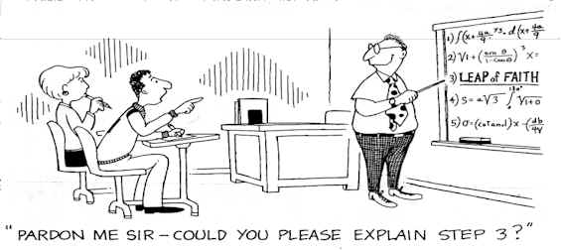
“ The mind is not a vessel to be filled. It is a fire to be kindled.” Plutarch

Slide 18

Strategies for Studying Mathematics
Habits – Having good habits can have a tremendous impact on your anxiety. Lets work and construct good habits that may be useful to you.
Building good math habits:
Before class
During class
After class
Doing homework
Before an exam
During an exam
After an exam

Slide 19
Good Math Habits – Before Class
Setup a study schedule
Review the relevant parts of the textbook before the lecture
Look ahead and try to get an idea about what you will be covering tomorrow. This concept is called, “flipping the classroom”. If you have a some understanding of the concept prior to lecture, you may assimilate the information much more efficiently.
Don’t miss class
If you miss class, it is your responsibility catch up on the material you missed. Contact your instructor as soon as possible to find out what you missed. Your instructors also like to be informed ahead of time as well if you know you are going to be absent.

Slide 20
Good Math Habits – During Class
Lectures: Not just the professor’s job, you have to do your part.
Details vs. focus on the presented ideas. Find a balance.
If your professor says something that makes sense to you, write it down. Don’t just copy what is on the board. THESE ARE YOUR NOTES!!! You are the one that has to understand them.
Pay attention
Attending class and not paying attention is like being absent. If you are going to attend class, get the most out of your time and focus on the content.
Ask questions
Don’t wait until after lecture if you have questions. If you don’t understand something right now, it may be needed or affect what your learning in 10 minutes. Raise your hand, chances are good that others have the same question or will benefit from going over your question.

Slide 21
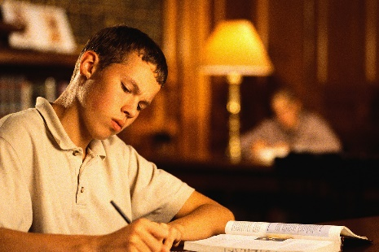
Good Math Habits – After Class
Self Study and Homework
Do homework ASAP
Do homework within 2 hours after class. Immediately after class would be best while the material is fresh in your mind and you don’t forget it!
Study math as much as possible.
5+ days a week, between 6-10 hours per week.
Know where to get help
Utilize your campus resources. The campus has many free resources available to students.
Lets take a look at some of these resources.

Slide 22
Free Student Resources
Please visit the ‘Skills4Success’ homepage through the canyons website:
http://www.canyons.edu/offices/cte/collegesuccess/
Supplemental Learning (SL)
Workshops -- Presentations and activities led by faculty
Practice Jams -- Additional practice activities led by tutors
Guided Learning Activities (GLAs) -- Computer tutorials available for topics in Math and English
The Learning Center (TLC) – Requires a valid COC ID card
Free tutoring in Math, English, Computers, Biology, Chemistry, Physics, Foreign Languages, etc.
Textbooks available for use within the lab
Solution manuals available for use within the lab
GLA access
SL Workshop access
Computer access
Study rooms available with technology and internet support
Library
Textbooks available for checkout
Study rooms available with technology and internet support

Slide 23
Good Math Habits – Homework
Do homework when it is assigned, NOT when it is due. Do all of the assigned homework.
Check your answers.
You can check your answers in the back of the book or with the solutions manual. Be sure you are checking your answers and not just copying them.
First few problems of the homework are usually routine
Textbooks usually have multiple examples of these types of questions.
Gradually they begin to stretch you, testing your comprehension and ability to synthesize ideas
As the questions become more difficult, there may or may not be examples available in the textbook to review. These questions are there to push and stretch your comprehension. Many times it takes one step to manipulate the question into a more recognizable form.

Slide 24

Good Math Habits – Stuck on Homework?
If you get stuck on a problem, what should you do?
Review the textbook and your notes.
Still stuck? Move on and try the next problem or set of problems.
Remember the variety of resources available to you. You have access to tutoring labs, office hours, instructor email, and other internet accessible options such as Khan Academy.
Get help as soon as possible.
Highlight or list the questions you have to ask your instructor about.
Write down exactly what you have questions about so you don’t forget.

Slide 25
Ways that no homework gets done
Look over exercises and conclude, “I don’t understand this and don’t know how to do it.” – close the book!
Go to the beginning and try the easier problems or examples. Spend some time and work at them.
Look over the exercises and conclude, “I understand it so I don’t need to do the homework.” – close the book!
You need to put in the time and practice. Writing it out is vital for learning the material. Challenge yourself, go to the ending and more challenging questions.
Didn’t even open the book. – book stayed close!
Homework is usually worth a percentage of your grade. Spend the time and put in some effort to get that credit. Even if homework is not collected, it is in your best interested to get the practice. It builds good study habits and gives you exposure to the different ways that questions can be presented.

Slide 26
Good Math Habits – Homework
Give yourself time to read and write
The textbook is not a novel. Each line could take you several minutes to digest, and that’s okay! Write yourself notes on the side. Writing it out is far more effective than just highlighting or underlining.
Minimize distractions
Don’t have too many distractions. Some people need complete silence while others need some background noise. Find what works for you.
Work / collaborate with other students
Study groups can be a helpful way to learn and understand the material. The best way to really understand the material is when you teach it to others. Be sure to keep groups at a manageable size with members who are focused on wanting to learn the material.
Caution: Ever meet with a large group at 10am at Barnes & Noble and by 3pm in the afternoon you feel that you have gotten about a half hour of work done? Groups can be counter-productive, so find those fellow students with a dedication to learning the subject.

Slide 27
Word Problems!
I hate word problems!!! – close the book – NO NO NO!!!
The study of math can help provide you with a sense of power over the real world.
Most students do not like word problems and shut down before even reading the first word.
The most popular question that students ask usually comes in the form, “When am I ever going to need or use this?”
The answer to this question will most likely be an example in the form of a word problem. Your boss will not hand you a sheet of paper and ask you to “solve for x” twenty times and then get back to him. He is more likely to ask you something like:
We need a new supplier of flapdoodles. Bob’s Flapdoodle Emporium wholesales them at $129 per gross, but charges $1.25 per ton per mile for shipping. Sally’s Flapdoodle Express wholesales them at $143 per gross, but ships at a flat rate of $85 per ton. Figure out how each of these impact our marginal cost, and report to me this afternoon.
You may have to read the question a few times. Try reading the question without getting caught up on the numbers. Figure out what the question is asking then start writing down the important points of information.

Slide 28
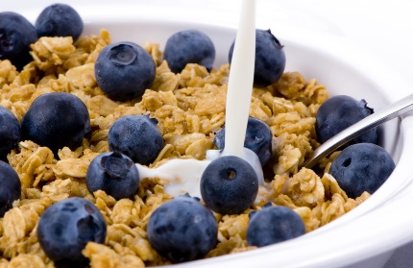
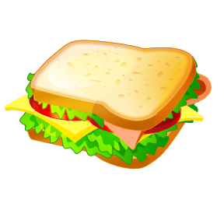
Good Math Habits – Before an Exam
Don’t CRAM!
The brain is in many ways just like a muscle. Would you prepare for a race or marathon by staying up and running all night the night before? No, but you do warm up for it. The same goes for taking exams. Some students continue to cram and do “alright”; however, you are much less likely to retain the information.
Prepare as soon as possible.
Practice, practice, practice! Redo homework problems. Try them out of order or make flash cards. Do the reviews and practice tests in the book. Time yourself as you practice.
Eat.
Eat at least 2 hours before an exam so you have time to digest. The brain will make a demand on blood supply so don’t eat a large meal. A large coffee from Starbucks does not count as a meal.

Slide 29
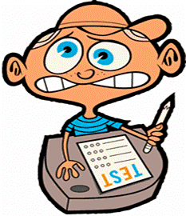
Good Math Habits – During an Exam
Follow directions. Ask your instructor if you have any questions. The worst your instructor can do is tell you they can’t answer your question.
When you receive the exam.
Write down formulas / notes you don’t want to forget.
Find those specific problems you don’t want to forget how to do.
Expect an initial panic. Take a deep breath and let it out slowly.
Look through the exam and make little notes on specific problems.
Get stuck or not sure how to solve a problem?
Mark the problem and come back to it.
Read through the entire problem so your brain can work on it. You may reach another problem that will spike your memory on how to solve one you skipped or were not sure on.
Manage your time.
It’s not a race, don’t worry if others turn their exam early.
Work efficiently. Be methodical and complete in your solutions.
Give yourself some time at the end to review your work and answers. Have little mistakes added up and cost you on an exam?
SHOW YOUR WORK – Full or Partial Credit

Slide 30
Good Math Habits – After an Exam
When you get your exam back.
Do not crumple up your exam, stuff it in your backpack, take it home and burn it in the fire place.
Discover your mistakes and understand them.
Utilize resources to go over and correct the mistakes you made. If you don’t learn from your mistakes, you will likely make them again.
Finished the exam and done?
Review previous material.
Go over old exams, quizzes, and homework. You want keep the previous material as fresh as possible. This will make preparing for the final exam much easier and less intimidating.

Slide 31
Good Math Habits – Final Exam Preparation
Prepare now!
Create a crib sheet of formulas and notes for each chapter. Leave a few pages in the front of your notebook write down things you don’t want to forget from each chapter as you are learning them during the semester.
If you wait till the end of the semester to start reviewing for the final, then you are cramming!!
Work backwards.
Working backwards will start with the material that is fresher in your mind. You will work faster and since some material uses material from before, you also be covering that earlier material.
Go through your old exams.
Your exams throughout the semester are a perfect outline and study guide for the final. If you have gone over and corrected your mistakes from old exams, you now have a solution key to a final review packet.

Slide 32
How to change a bad math attitude into a good one?
Start good math habits.
Create good math experiences.
Find ways to make math enjoyable.
Fake it.
Use positive self talk (say it till you believe it).
Fake confidence until you are confident!

Slide 33
The Math Cycle: Good or Bad? It’s up to you!!
Math
Experiences
Math
Attitudes
Math
Habits

Slide 34
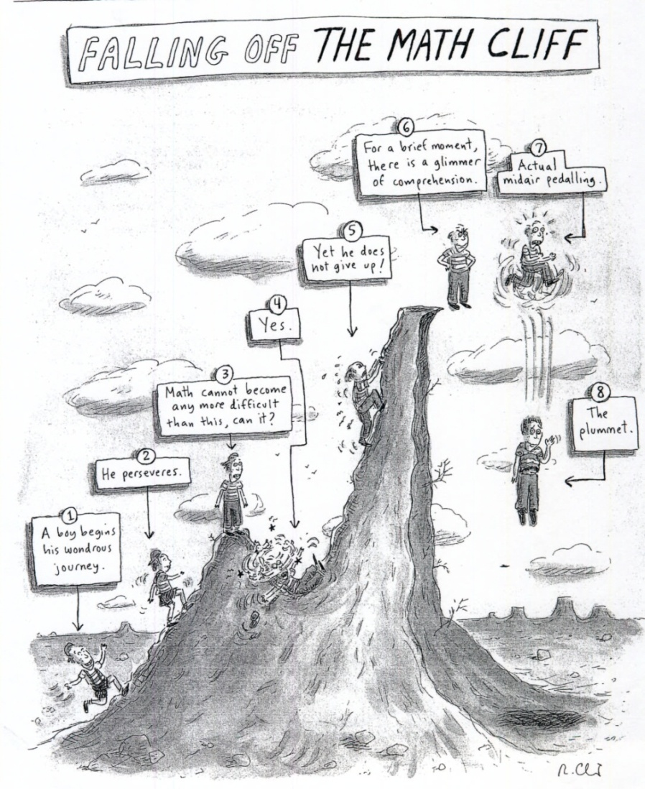
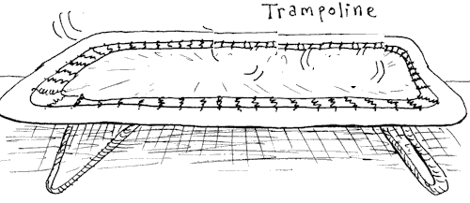
Panic Attack !
Bouncing Back

Slide 35
Discussion Questions
What was the most interesting advice or fact you learned today?
What advice do you think you can start incorporating immediately?
What advice will you have the most trouble following?

